Slide 1
Code Generating
5/Jun/2019

Slide 2
Contents
Problem Statement
Progress
Future Work

Slide 3
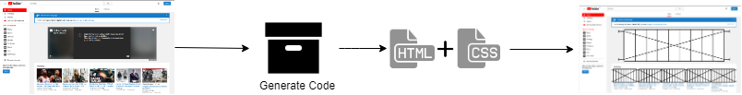
Problem Statement
Final Goal:
Generate the front-end code from any given web page screenshot

Slide 4
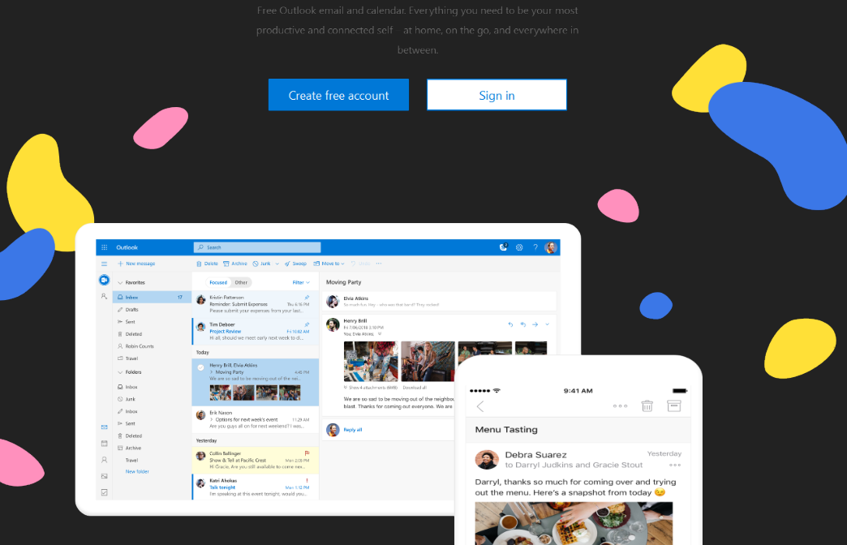
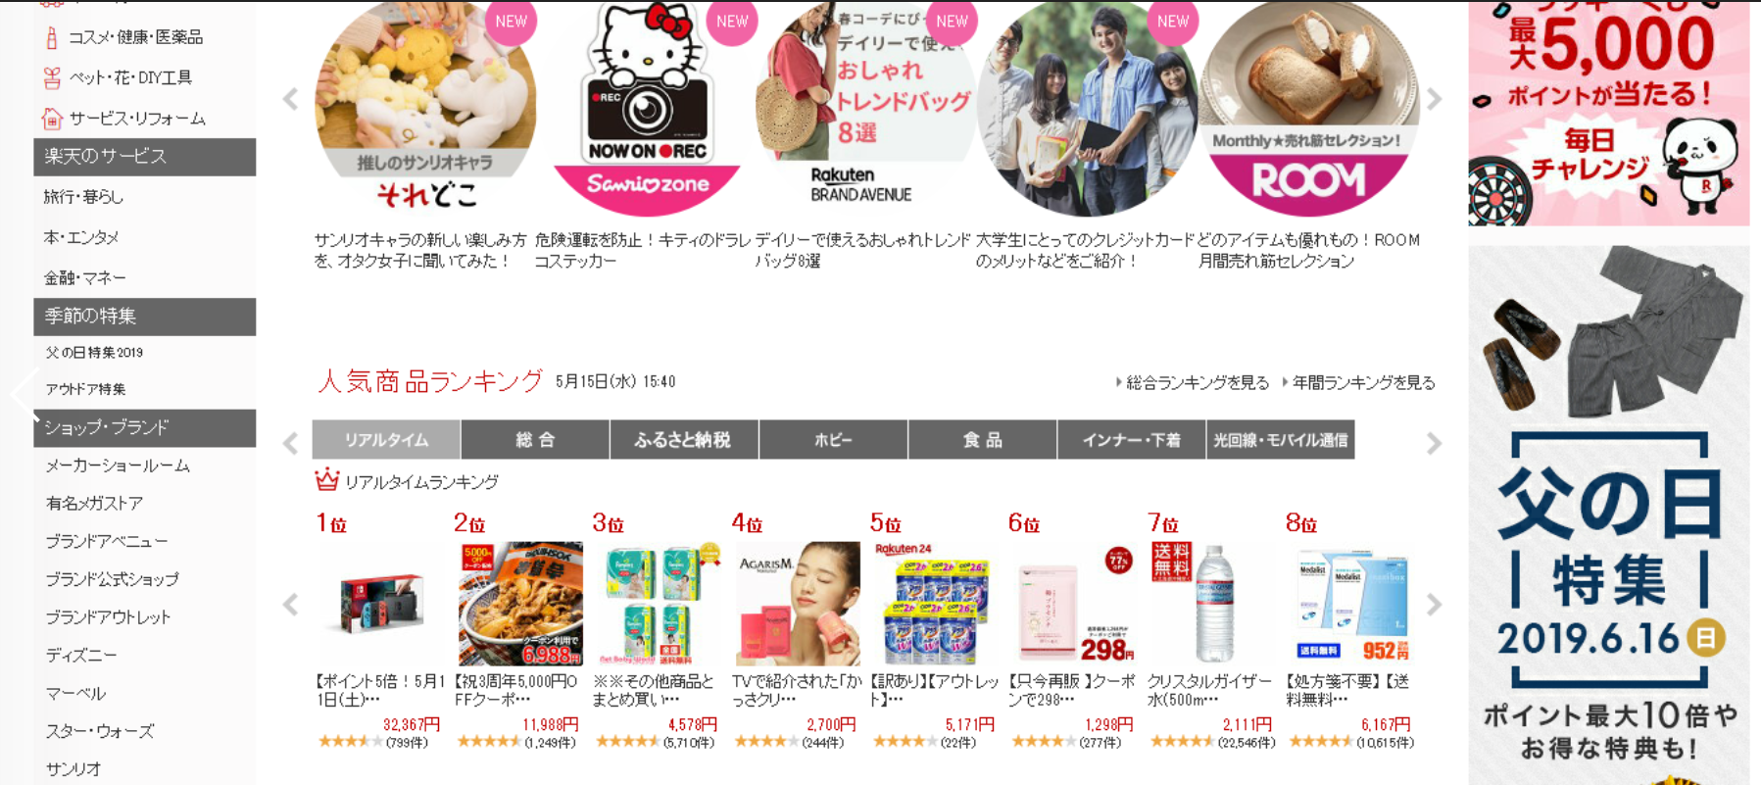
Problem Statement
Core Problem:
The disturbance caused by images on the page: Misrecognize contents of the <img> as the web components.

Slide 5
Problem Statement
Core Problem:
The disturbance caused by images on the page: Misrecognize contents of the <img> as the web components.
Solution:
Detect and Separate the image components on the screenshot firstly.

Slide 6
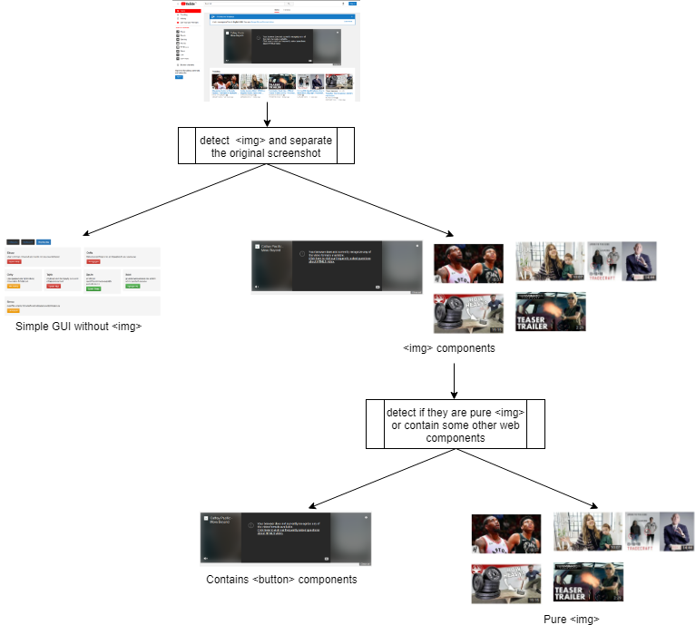
Progress
Solution:
Detect and Separate the image components on the screenshot firstly.

Slide 7
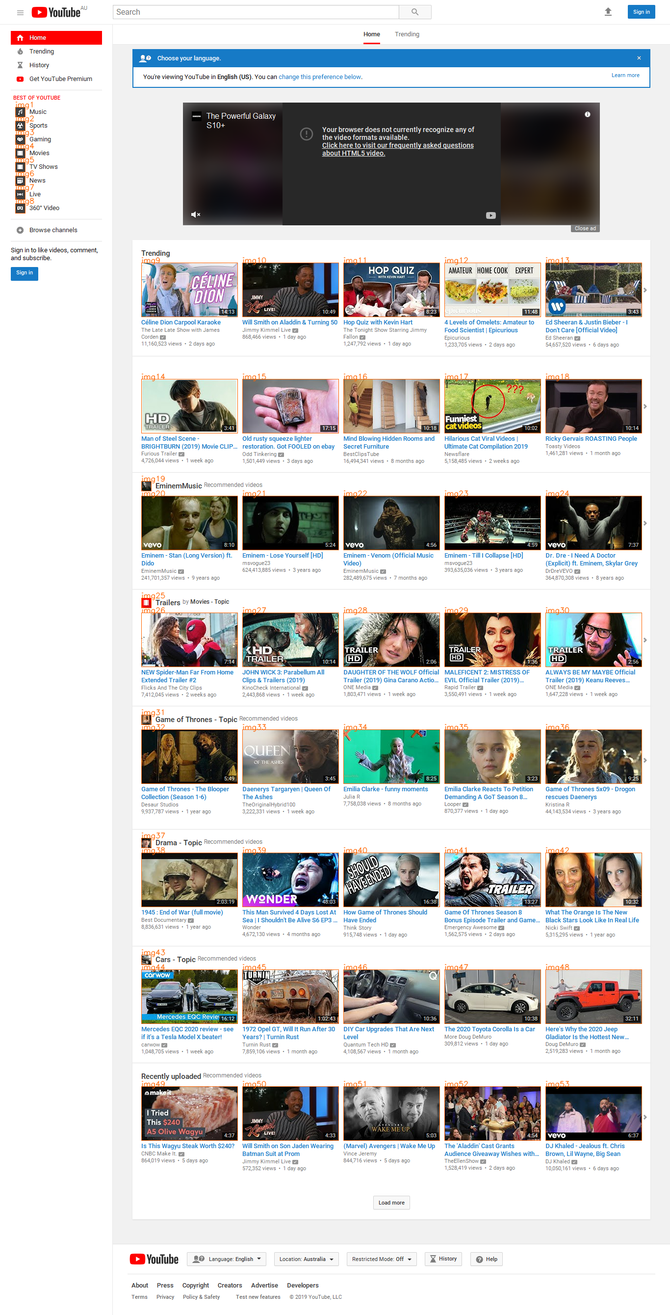
Progress
Datasets:
Label + Full-size screenshot

Slide 8
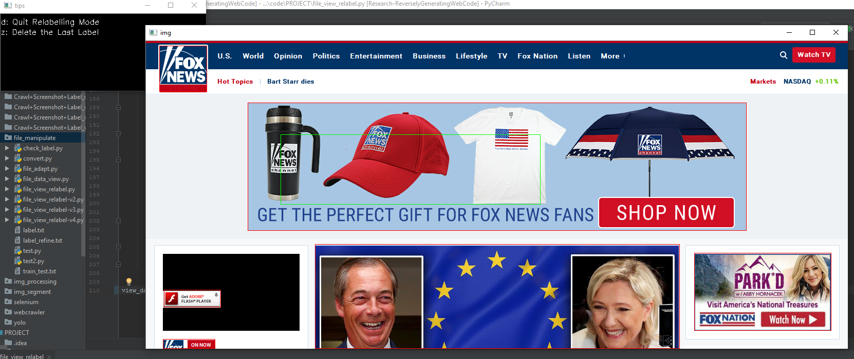
Progress
Datasets:
Label + Full-size screenshot
Supplementary:
Because of the misidentification in the label crawled from the Internet, manually check and relabel the dataset

Slide 9
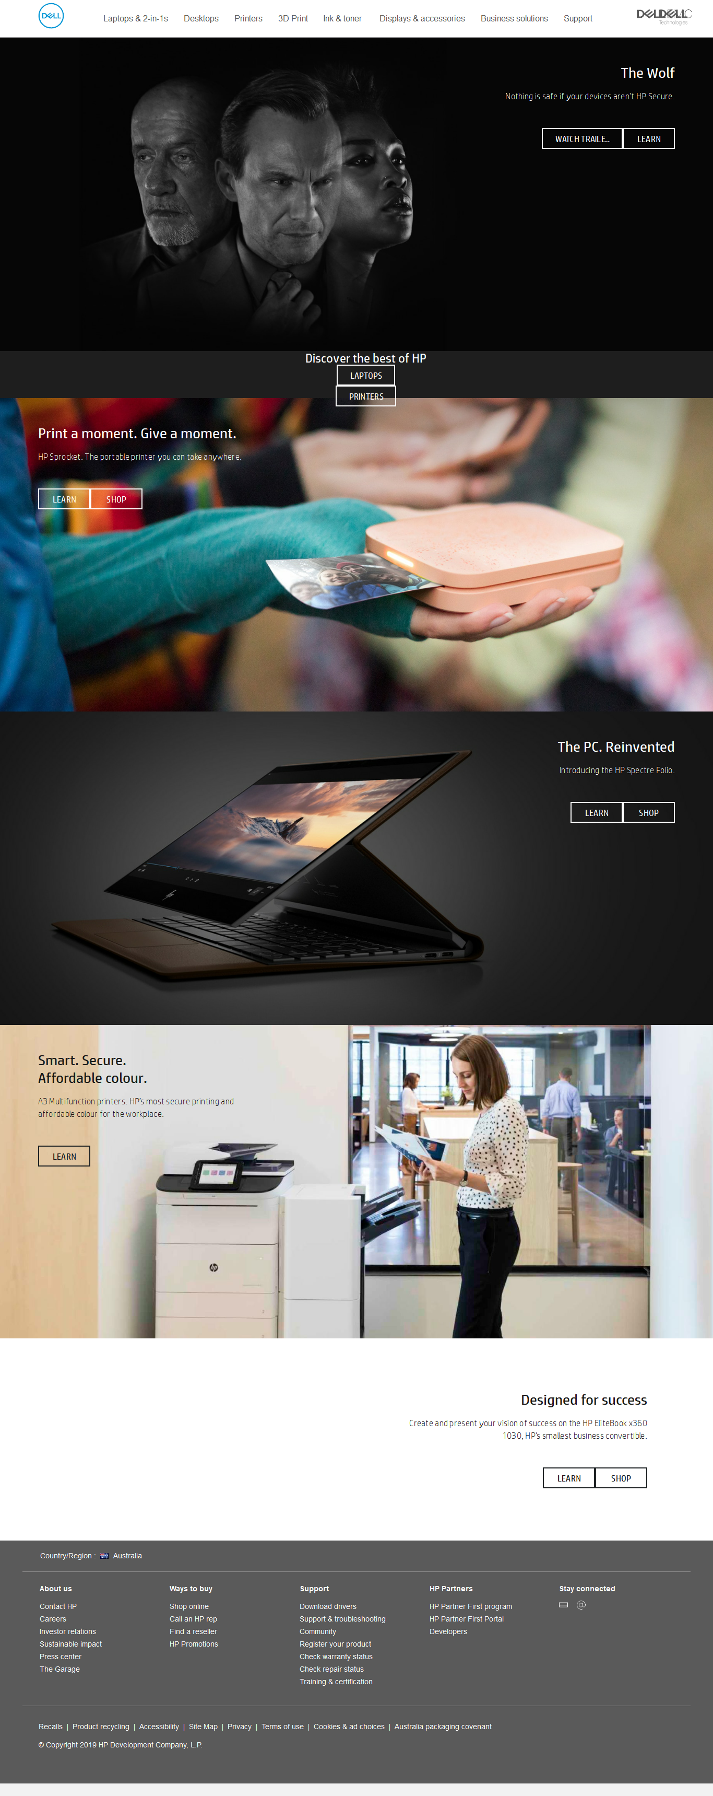

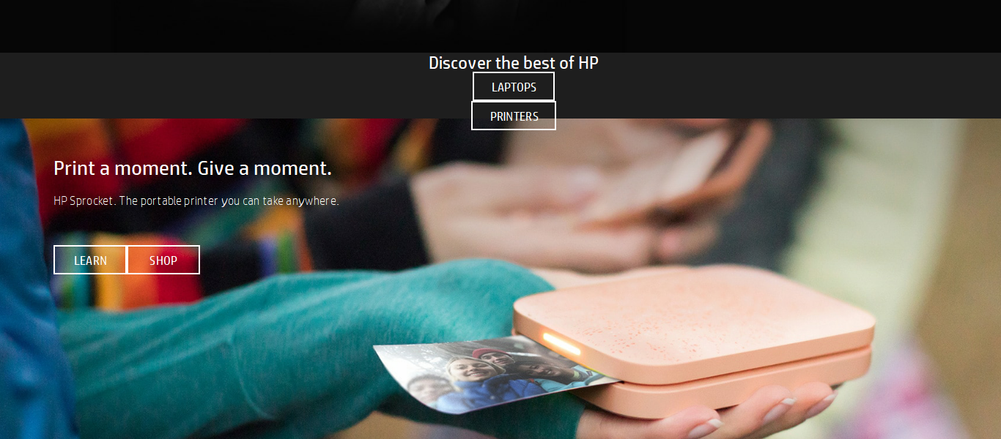
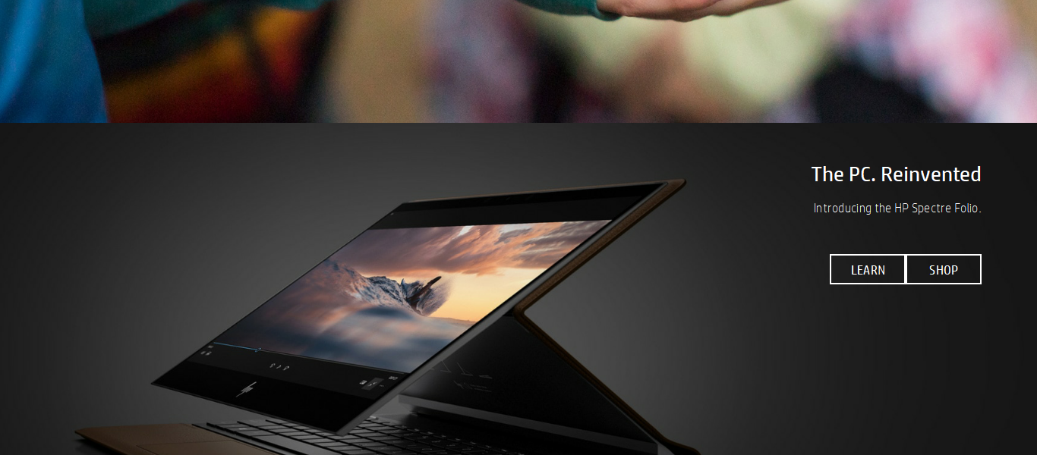
Progress
Preprocess:
Segment the original long image into several section images with fixed size.
Purpose:
Avoid the loss of information caused by overresize.

Slide 10
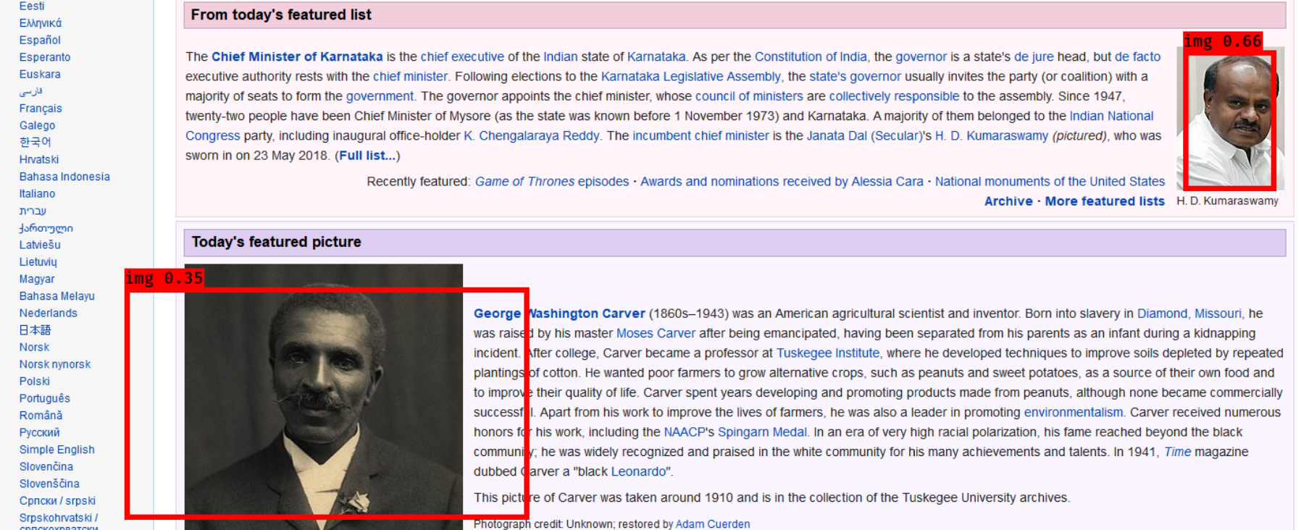
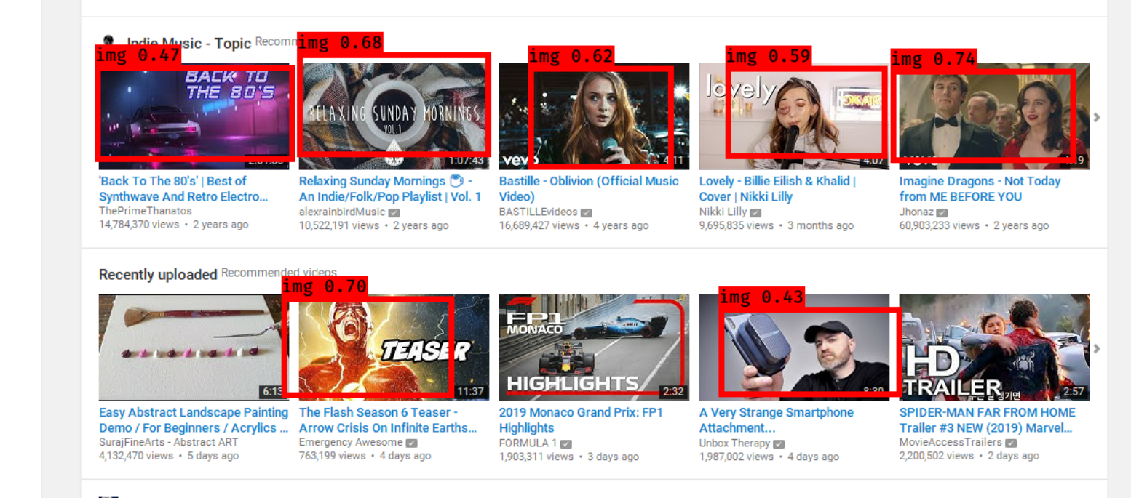
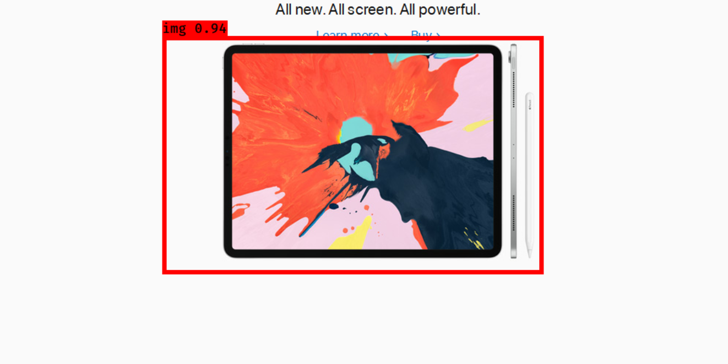
Progress
Experiment1: ML
YOLOv3 + VGG16
Trained on 450 images

Slide 11
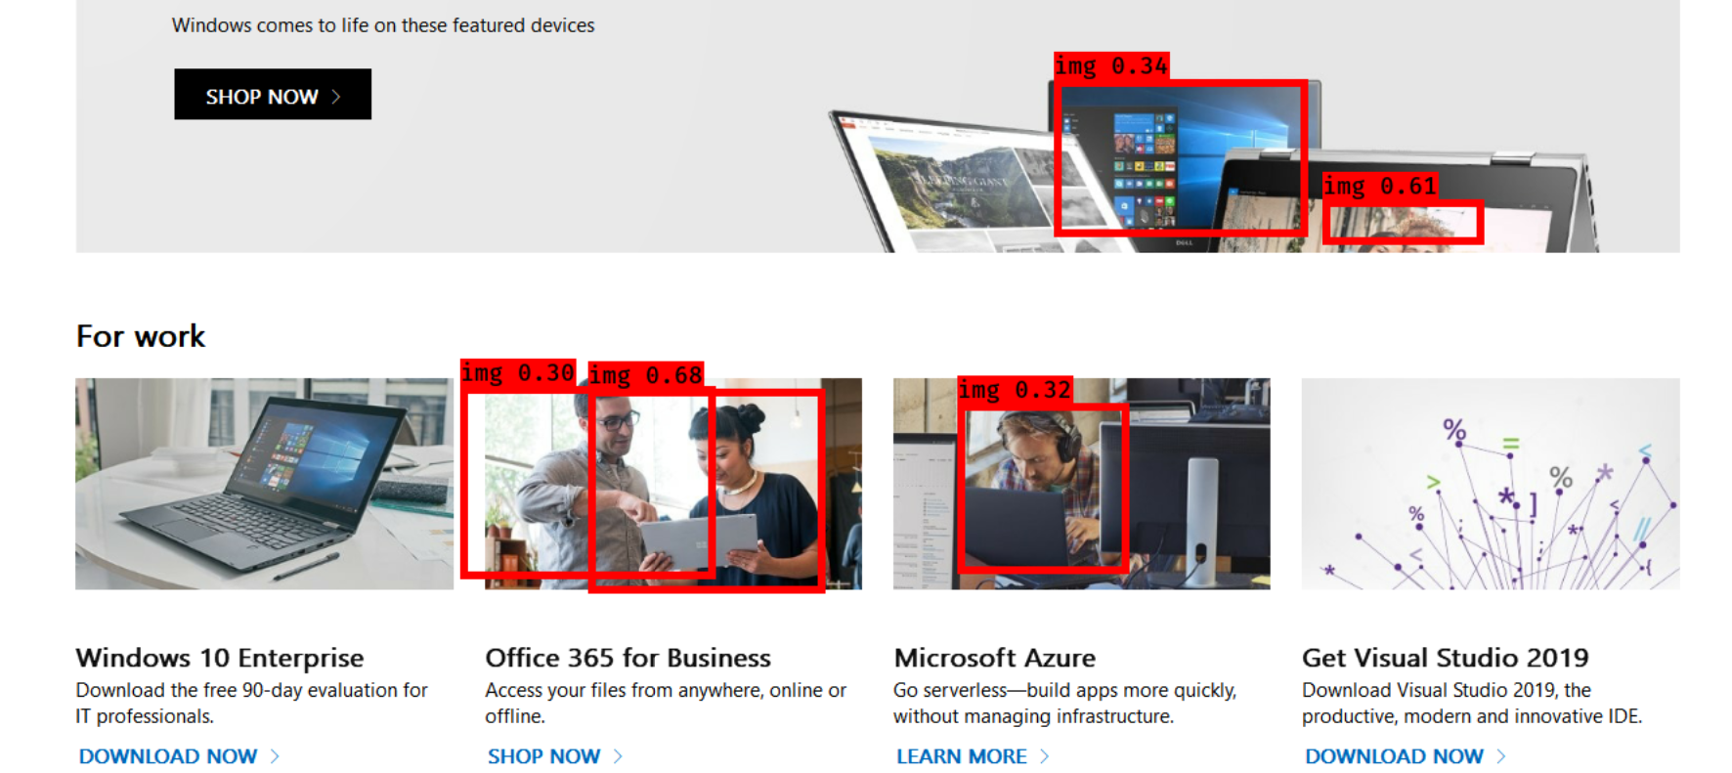
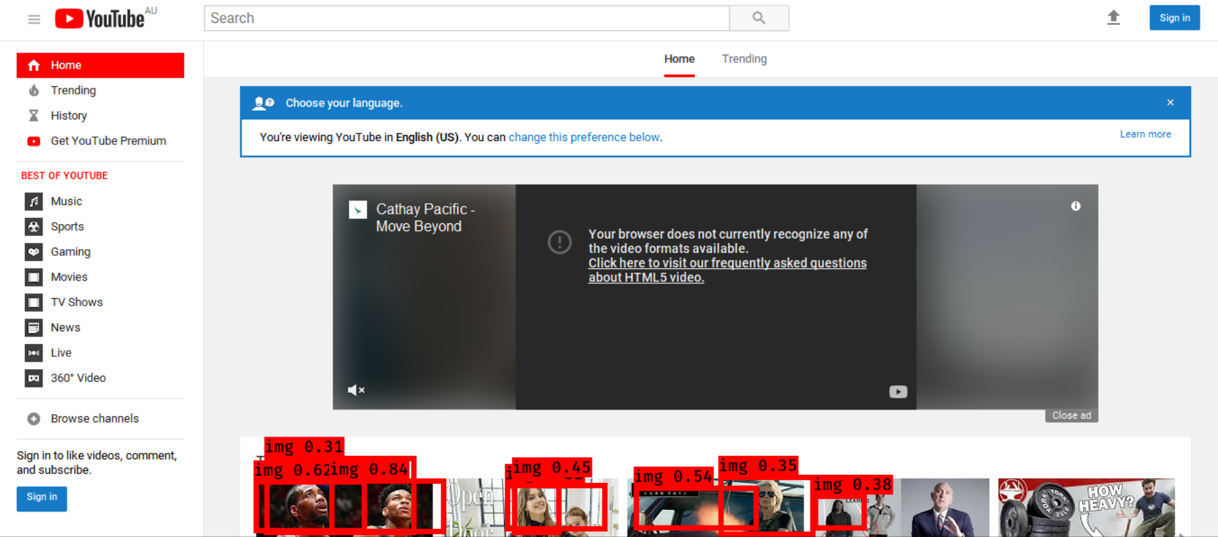
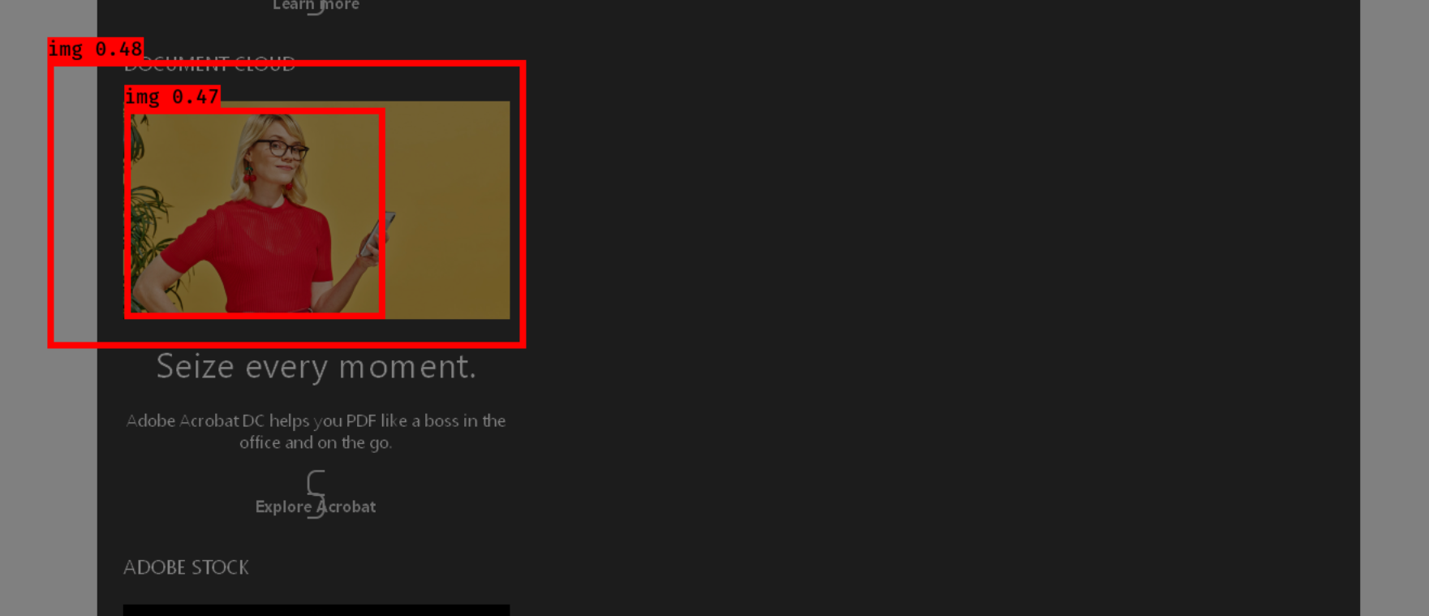
Progress
Experiment1: ML
YOLOv3 + VGG16
Trained on 450 images

Slide 12
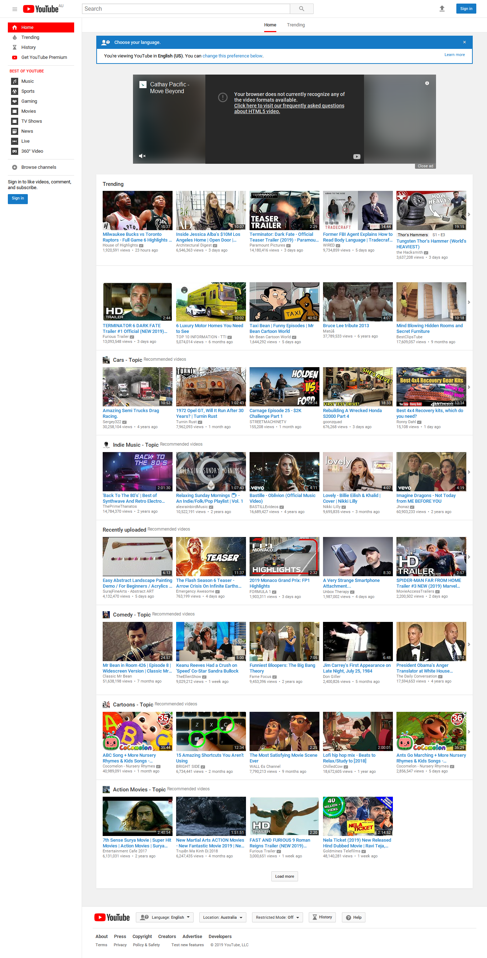
Progress
Experiment2: CV
First Stage Purpose:
Detect the rectangle areas that are colorful and complex in an image

Slide 13
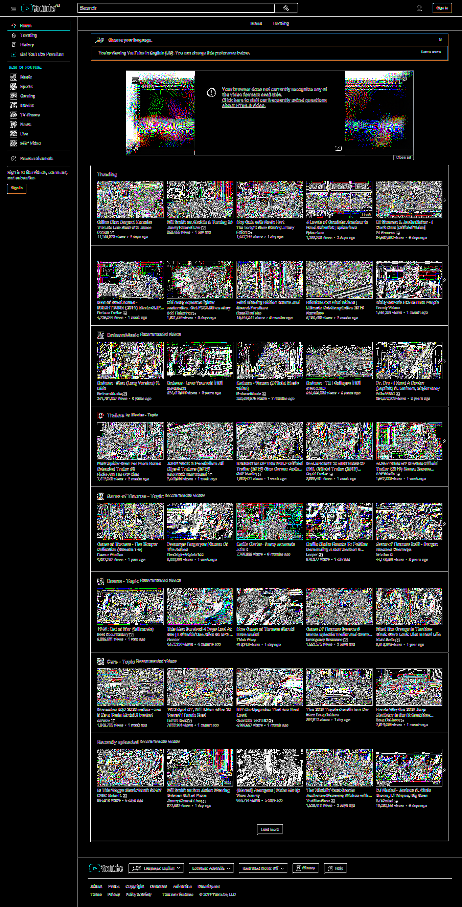
Progress
Experiment2: CV
Preprocess:
Calculate Gradient + Median Filter

Slide 14
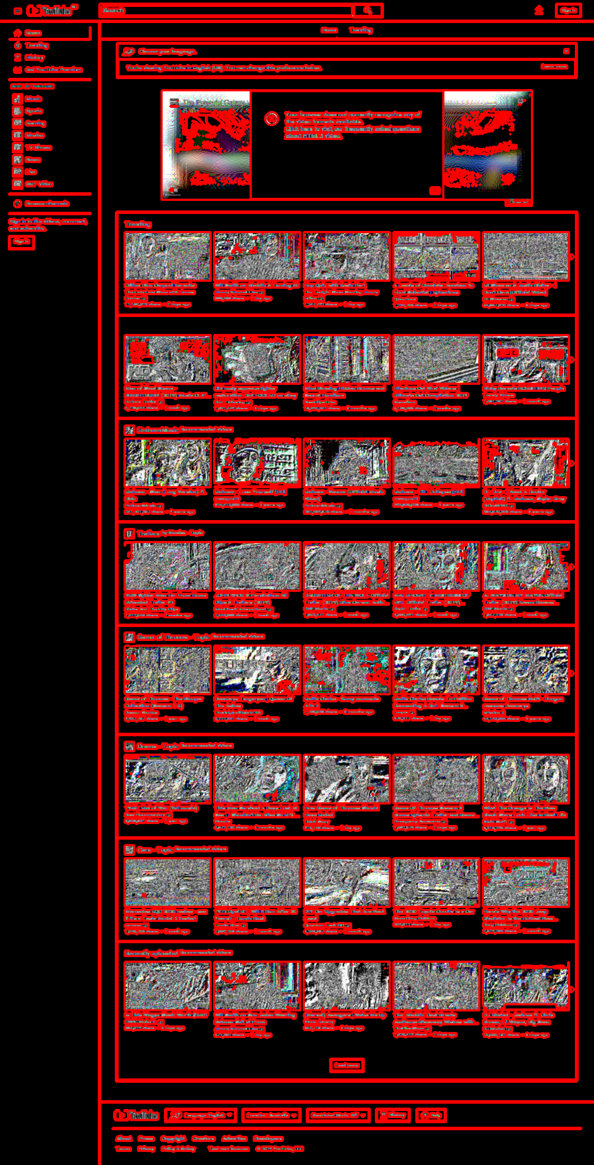
Progress
Experiment2: CV
Attemt1:
Gradient + Edge + Findcountours
Issue:
Hard to recognize the rectangle

Slide 15
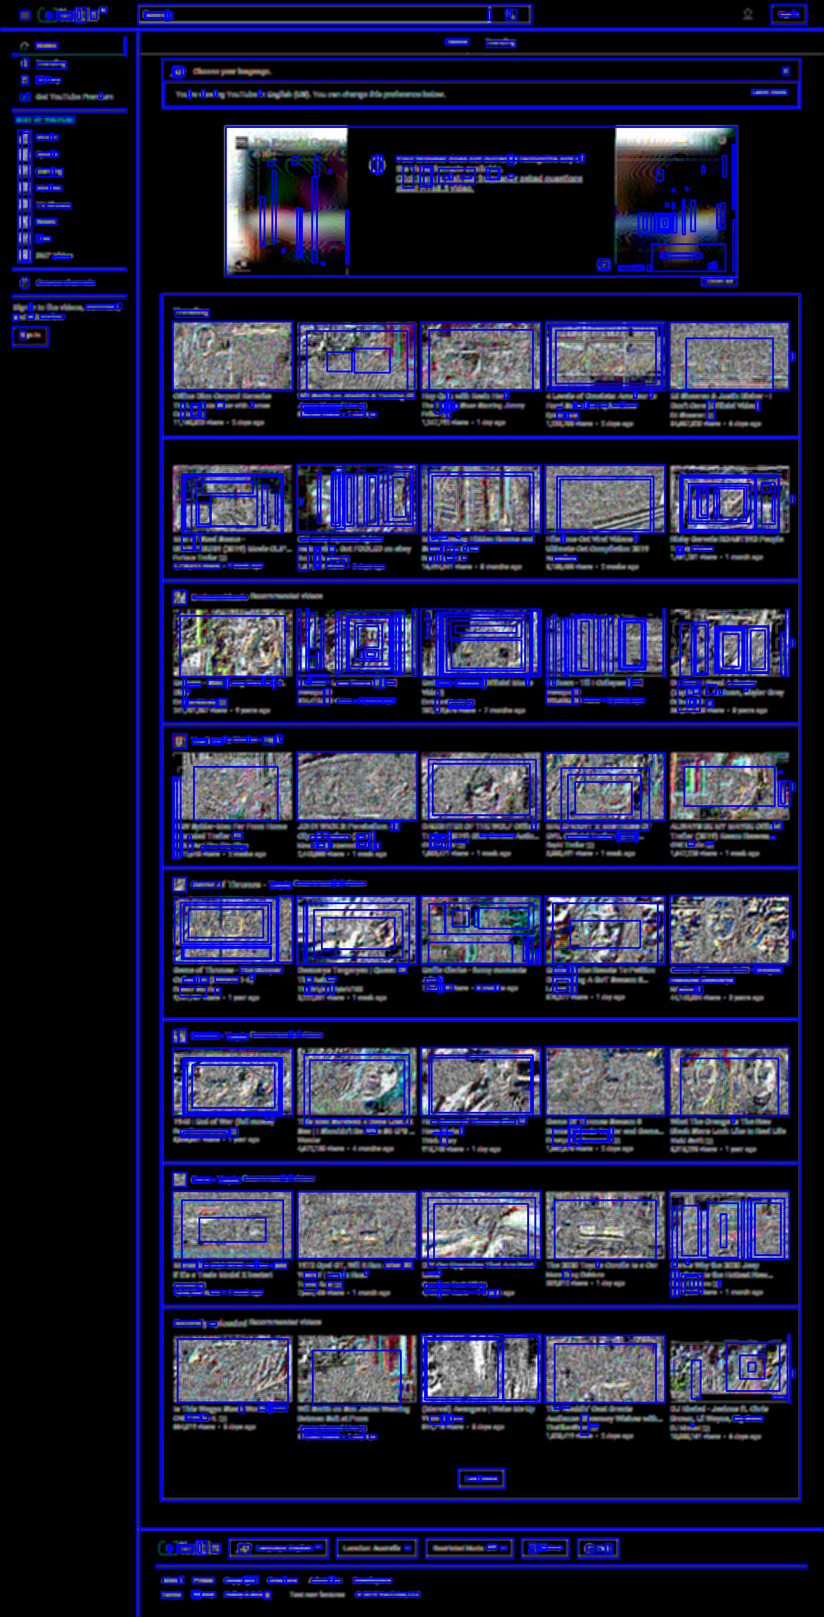
Progress
Experiment2: CV
Attemt1:
Gradient + Edge + Hough Transform
Issue:
Rectangles Overlap
Computationally Expensive

Slide 16
Future Work
Direction:
Machine Learning
Computer Vision

Slide 17
Future Work
Machine Learning
Potential Improvement on Current Model:
More data (The dataset is small now but the result is already not instructive)
More training epochs (Current 600 epochs but the convergence has not been reached)
New Model Idea:
Introduce the rectangle proposal

Slide 18
Future Work
Computer Vision
Potential Improvement on Current Model:
Hough Transform: Refer to the idea of preset-size anchor in YOLO instead of iterate the whole 4-dimension computation space
Overlap Check
New Model Idea:
The image pattern technique

